Slide 1
OLS, KNN and CV
Building models and validation

Slide 2
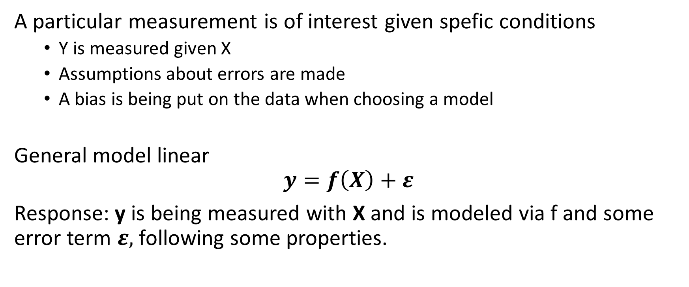
Supervised data analysis
A particular measurement is of interest given spefic conditions
Y is measured given X
Assumptions about errors are made
A bias is being put on the data when choosing a model
General model linear
$$y=f\left(X\right)+ε$$
Response: y is being measured with X and is modeled via f and some error term $ε,$ following some properties.

Slide 3
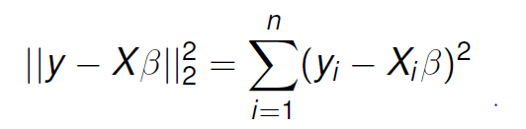
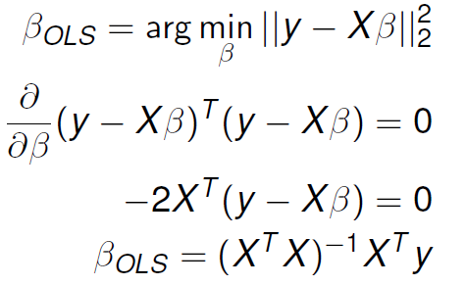

Ordinary least squares
Model
$y=Xβ+ε$
Solution
Problems with the OLS:
Benefits with the OLS:
Correlated predictors are a problem
Interpretation with many variables is difficult
Overfitting is easy on testing data
Simple model very easy to do
Most unbiased model for training data
A good starting model
Can be used for both categorical and numerical data

Slide 4
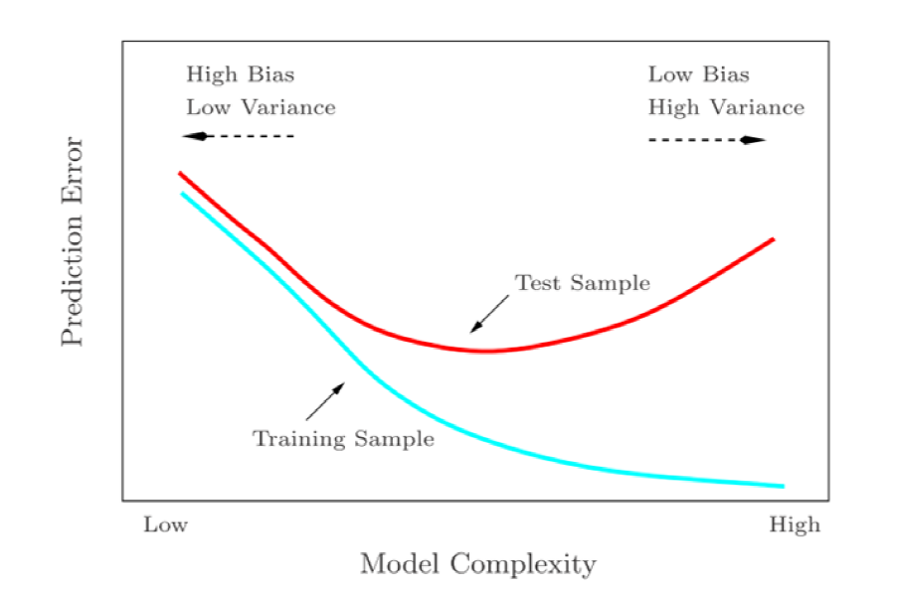
Bias – variance trade off
Probably the most important concept to keep in mind when modelling data.
Bias: model complexity to reach true value
Variance: how well can the model capture data with each new dataset

Slide 5
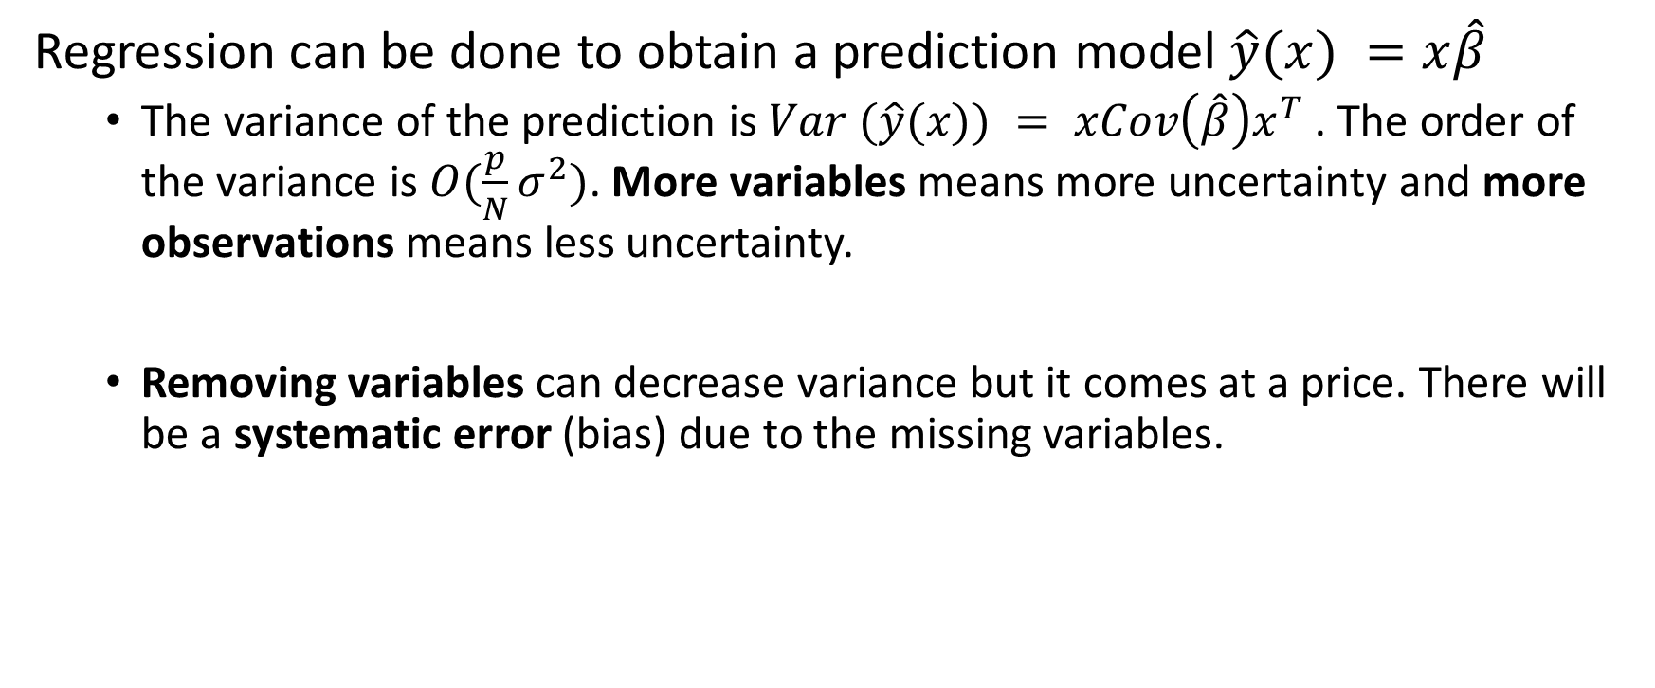
Prediction in regression
Regression can be done to obtain a prediction model $\hat{y}(x) =x\hat{β}$
The variance of the prediction is $Var (\hat{y}(x)) = xCov\left(\hat{β}\right)x^{T}$. The order of the variance is $O(\frac{p}{N}σ^{2})$. More variables means more uncertainty and more observations means less uncertainty.
Removing variables can decrease variance but it comes at a price. There will be a systematic error (bias) due to the missing variables.

Slide 6
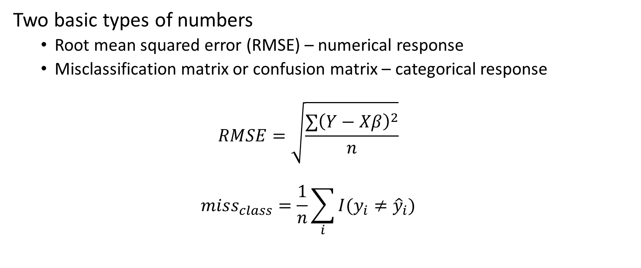
Prediction accuracy measurements
Two basic types of numbers
Root mean squared error (RMSE) – numerical response
Misclassification matrix or confusion matrix – categorical response
$$RMSE=\sqrt{\frac{∑{\left(Y−Xβ\right)}^{2}}{n}}$$
$$miss_{class}=\frac{1}{n}\sum_{i}{I(y_{i}≠{\hat{y}}_{i}) }$$

Slide 7
Finding the optimal linear model
Many approaches, but all are based of two
Forward selection
Backwards selection
Forward selection
Add terms one at a time test these via goodness of fit measure
Keep doing it until no improvements may be found
Backward selection
Add all terms to begin with and remove one by one via goodness of fit measure
Keep doing it until no improvements may be found
Do this manually or via the steps/leaps algorithm
Example on blackboard and in R

Slide 8
Cross-validation
Optimal choice
Make independent training, validation and testing dataset
Almost optimal= cross-validation (CV)
Split data into training-validation set and testing set
Split should be random
Types of CV
Leave one out (loo)
Non repeated k-fold cv
Repeated k-fold cv
Danger!!! Your dataset may not be optimal (Design of experiments is your friend – a different course)

Slide 9
Optimal linear model now with CV
Example shown in R script

Slide 10
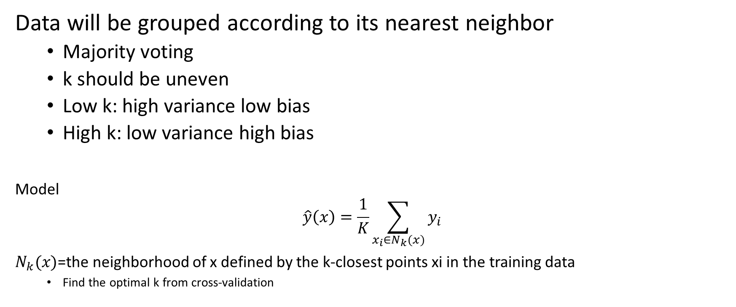
KNN: a very unbiased model
Data will be grouped according to its nearest neighbor
Majority voting
k should be uneven
Low k: high variance low bias
High k: low variance high bias
Model
$$\hat{y}\left(x\right)=\frac{1}{K}\sum_{x_{i}∈N_{k}(x)}{y_{i}}$$
$N_{k}(x)$=the neighborhood of x defined by the k-closest points xi in the training data
Find the optimal k from cross-validation

